Slide 1
How Do Voice Assistants Impact Our Lives?
CS 5337 Advance Software Engineering
Senior Design Final Project
Group - Neo Praxisoft
Neha Das
Ismael R. Valenzuela
Jessie George
Yash Shah
Monisha Barns

Slide 2
Motivation
We live in a world that is dominated by the internet. While technology and the internet can be beneficial, there is always a downside. There's a catch or there's trouble ahead.
Particularly with young kids and the elderly, they are not aware of the negative aspects of the internet. Over the past few years, the Internet has evolved from sending emails through older computer systems to getting things done with just a simple voice command.
As a result of voice recognition, human lifestyle has changed, but we don't know whether this change is good or bad. As a result of thinking about this situation, we came up with the project "How does voice assistance affect our lives?"

Slide 3
Voice Assistants
What is a voice assistant? It's software that carries out everyday tasks via voice command. It's bringing AI and machine learning together to recognize our voice and do what we ask it.
Able to integrate into most devices cell phones, computers, vehicles, smart watches and IOT devices.
An ever increasing dependency on AI/Robots critics of AI proclaim “AI is now more dangerous!”, resulting in a loss of popularity among the public.

Slide 4
Which voice assistant to choose?
Researched Google, Siri, and Alexa datasets for Google and Siri consists of a lot of NDA and public dataset is not accessible.
We have access to amazon customer reviews dataset for Alexa.
So we made a decision to move forward with implementing the project using voice assistant Alexa.

Slide 5
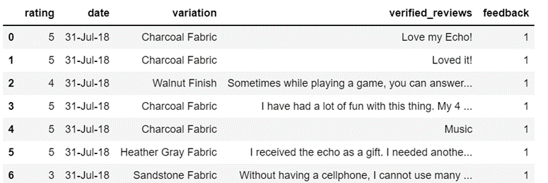
DATASET
Contains 3000 Amazon customer reviews as input text, star ratings, date of review, variant and feedback of various amazon Alexa products like Alexa Echo, Echo dots, Alexa Firesticks and etc.
This dataset can be used to analyze Amazon Alexa’s product, discover insights into customer reviews and assist with Machine Learning models.
The dataset doesn’t look clean for performing the Modelling, so some basic prerequisites steps needs to be performed.
Visualization and scaling for the data set may be needed.

Slide 6
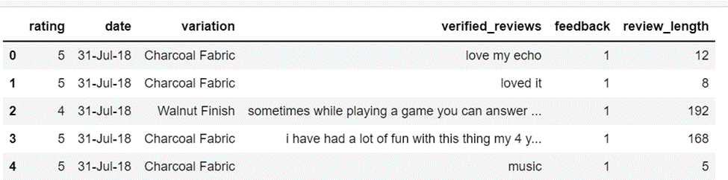
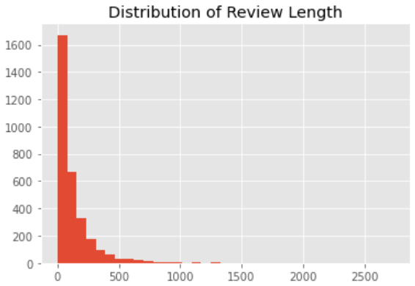
DATA ANALYSIS
To begin with, we transformed string data and removed punctuation in the verified reviews column of the original dataset.
For further analysis and data visualisation, length of review was calculated and was stored under attribute called review_length.
Mean, Standard deviation were calculated in order to check the uneven distribution of data. We visualised the review_length using histogram.

Slide 7
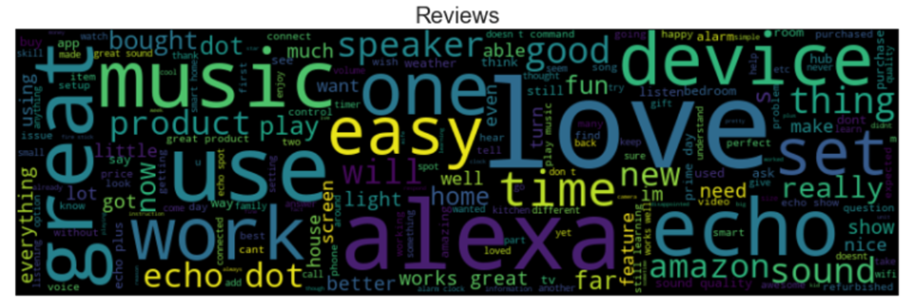
Data Visualization
For the visualization of the words, we are using a library called WORD-CLOUD.
A WORD-CLOUD is a collection, or cluster, of words depicted in different sizes. The bigger and bolder the word appears, the more often it’s mentioned within a given text and the more important it is.
Above Figure, is the first word-cloud by using Amazon logo(AMAZON). We can see some normal words and positive reviews. For positive parts we can see some good quality words like Love/good/new/ great/use/work..etc.

Slide 8
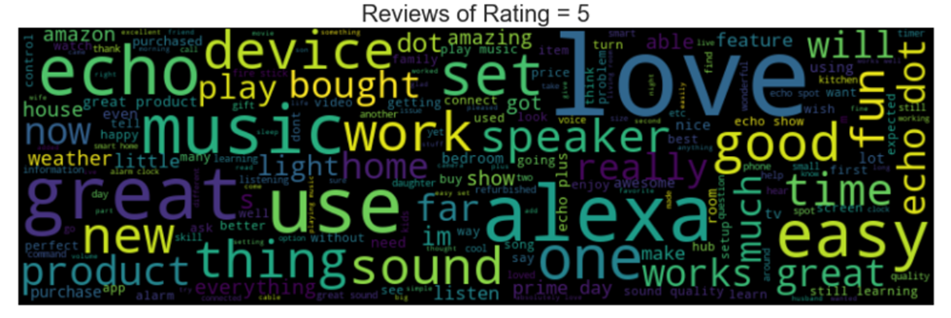
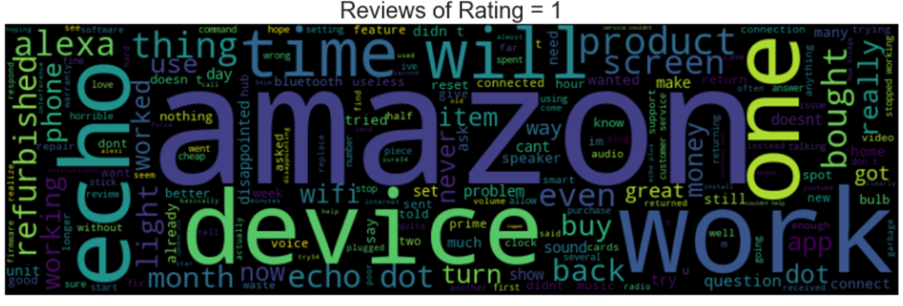
This figure says that Review of word cloud that has rating = 5 which is considered as best rating and has good quality words like love/good/easy.
This Figure says that Review of word cloud that has rating = 1 which is considered as worst rating and has bad quality words like refurbished/problem and etc.

Slide 9
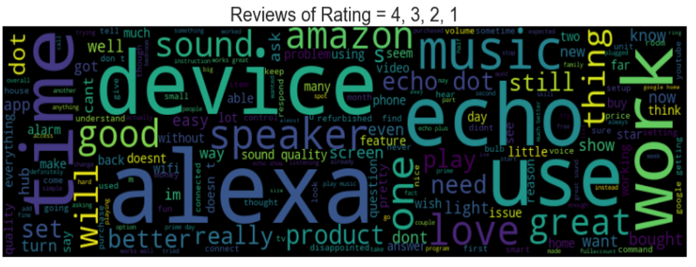
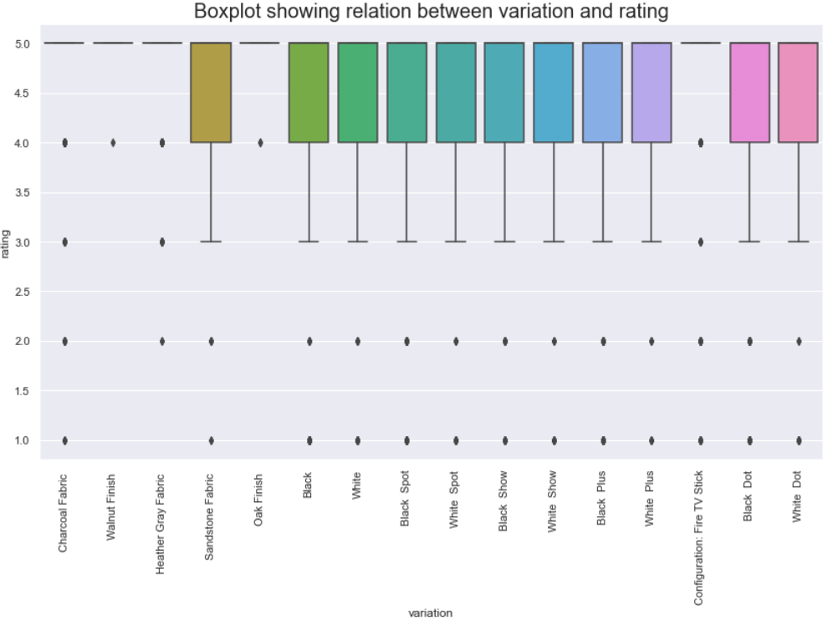
This figure is the word cloud that visualizes the customer reviews with mixed rating = 4, 3, 2, 1. We can see both good and bad quality words like love/ great/ disappointed/ doesn’t etc.
From this boxplot we can see that all the ratings w.r.t. product variation are completely biased. Most reviews for products belong to rating 5. Products with ratings 1 and 2 are considered as Outliers for each product variation.

Slide 10
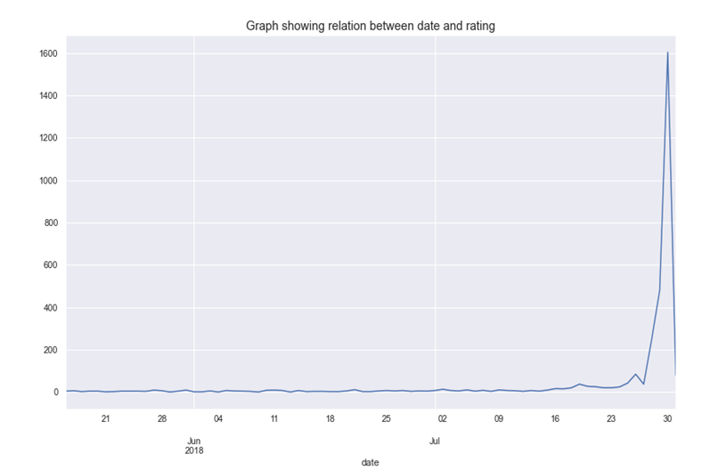
We need to consider certain scenarios to understand the Dataset:
# Since we have 3000 entries in the Dataset we want to check whether ratings are eccentric w.r.t. DataSet grouped by date.
# We saw from this plot that ratings are not eccentric, which means there is a probability that:
1. Data is biased even by Date.
2. Ratings seems to be taking peak value by the end July 2018.
3. Dataset has lot of reviews that may be incomplete or
generated by bots.
In Order to perform more analysis we will use BOX-PLOT. So what is BOX-PLOT?
A box plot visualization allows you to examine the distribution of data.
One box plot appears for each attribute element.
Each box plot displays higher distribution and lower distribution. Outliers appear as points in the visualization.

Slide 11
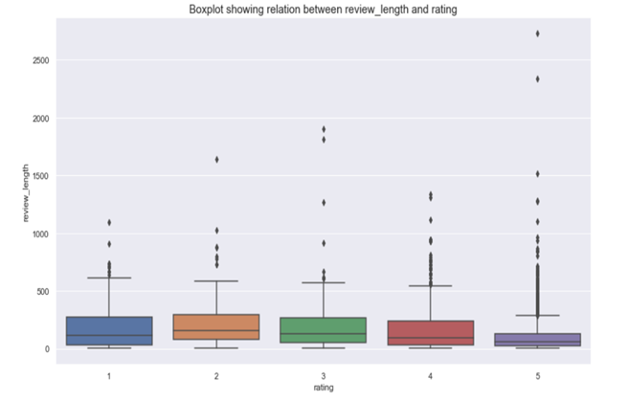
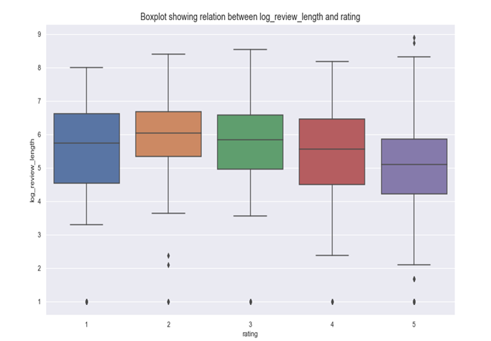
Figure 6: Boxplot showing relation between review_length and rating. From this it is clearly seen Rating 5 has lower distribution, but higher distribution cannot be predicted.
In Figure 7, we calculated the logarithmic scale of review_length in order to get accurate prediction. So, Rating 5 has lower Distribution and Rating 3 has Higher Distribution.

Slide 12
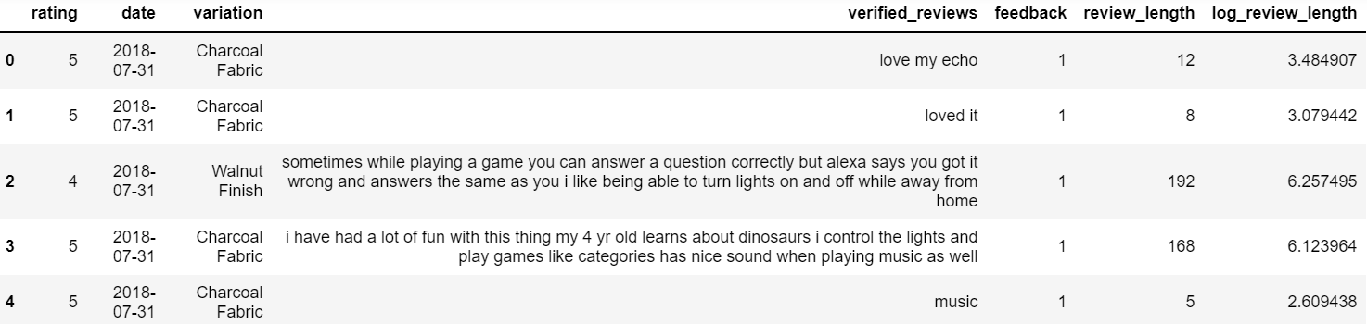
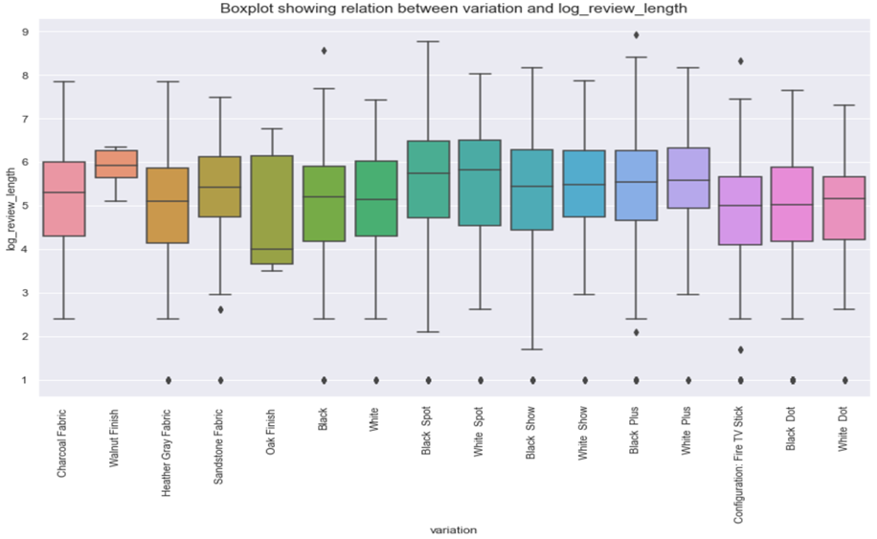
From this boxplot, we drew the conclusion that review_length on the logarithmic scale gives a better distribution range for rating and variation of the dataset. So we used log_review_length as a base for sampling criteria.

Slide 13
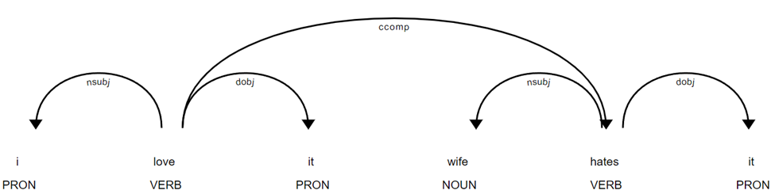
Word Embedding using SpaCy
Word Embedding in NLP is a form of word representation that bridges the human understanding of language to that of the machine. It represents words for text analysis in the form of vectors.
We chose SpaCy because it supports several transfer and multi-task learning workflows that can help improve the pipeline’s efficiency and accuracy. Transfer learning refers to techniques such as word vector tables and language model pretraining.
SpaCy has a single transformer or token-to-vector embedding layer between multiple components.
This Fig. shows the
Word Representation of SpaCy model en_core_web_sm which identifies the parts of speech and relations.

Slide 14
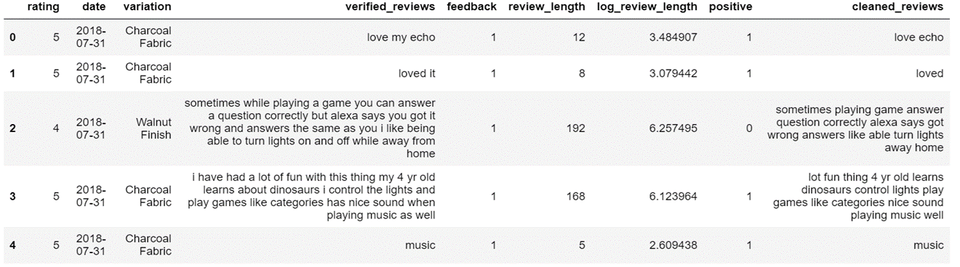
Word Tokenization
Tokenization is the process of splitting a sentence into smaller units.
In our dataset we removed the common Stop words (like the, it, my, while) and we stored the output in the column cleaned_reviews.
We included the boolean column “positive” in our dataset where rating = 5 corresponds to true,1 and ratings below 5 correspond to false,0. We used the Positive column for training and testing the dataset.

Slide 15
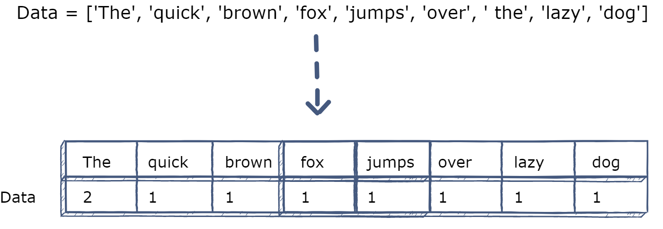
Model Implementation
Before implementing algorithm we need to split the dataset into train and test,so while splitting We came across one error that is “String cannot be converted to Floats”. We needed to convert the Strings in our dataset into float vectors. We used two types of Vectorizers:
Count-Vectorizer is provided by the scikit-learn library in Python. It is used to transform a given text into a vector on the basis of the frequency of each word that occurs in the entire text.
TFIDF-Vectorizer stands for term frequency - inverse document frequency. It is a measure of the originality of a word by comparing the number of times a word appears in a document with the number of documents the word appears in.
TF-IDF = TF(t, d) x IDF(t)
term t in document d

Slide 16
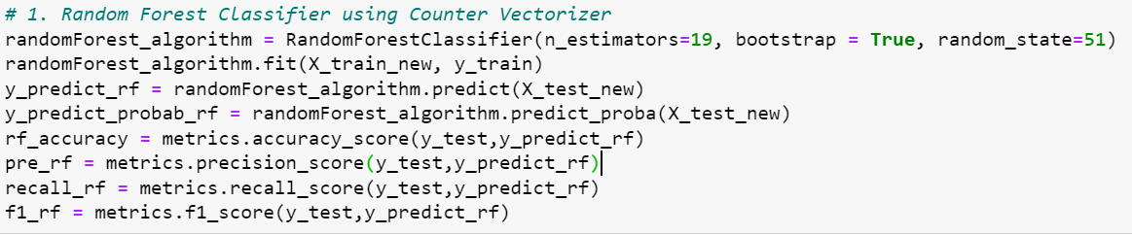
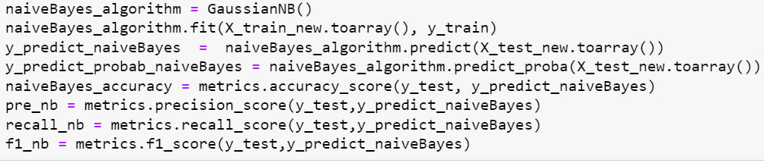
Algorithms Used and their Results
Random Forest Classifier : The random forest is a classification algorithm consisting of many decisions trees. It uses bagging and feature randomness when building each individual tree to try to create an uncorrelated forest of trees whose prediction by committee is more accurate than that of any individual tree.
Gaussian Naive Bayes: Gaussian Naïve Bayes is a supervised learning algorithm based on applying Bayes’ theorem with the naïve assumption of conditional independence between every pair of features given the value of class variable.

Slide 17
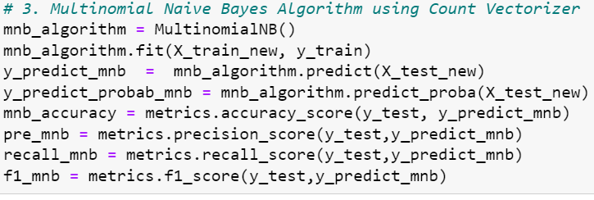
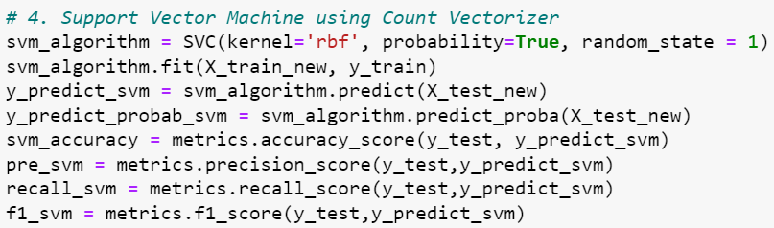
3. Multinomial Naïve Bayes Classifier: Gaussian Naïve Bayes is a supervised learning algorithm based on applying Bayes’ theorem. The multinomial model provides an ability to classify data, that cannot be represented numerically. Its main advantage is the significantly reduced complexity. The multinomial naïve Bayes is widely used for assigning documents to classes based on the statistical analysis of their contents.
4. Support Vector Machine: Support Vector Machine is a supervised machine learning algorithm that is used for both the classification and regression. The objective of SVM algorithm is to find a hyperplane in an N-dimensional space that distinctly classifies the data point. This algorithm finds the closest point of lines from both the classes specified. These points are called support Vectors. Here rbf kernel is used to store the support vectors during training and not the entire dataset.

Slide 18
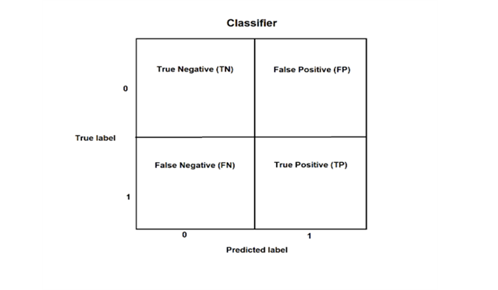
Confusion Matrix
The unequal number of data in each class can lead to inconsistent classification accuracy. Calculating a confusion matrix can help you figure out where your classification models are succeeding and where they are failing.
The true value of each row is connected and Columns are related to the predictions provided by the analyzed algorithm.
●True positive (TP) = Correctly predicted as fraudulent and true value is fraudulent.
●True negative (TN) = Classifier predicted not fraudulent and true value is not fraudulent.
●False Negative (FN) = Classifier predicted not fraudulent but in fact it is fraudulent
●False Positive (FP) = Not fraudulent but the classifier predicted as fraudulent

Slide 19
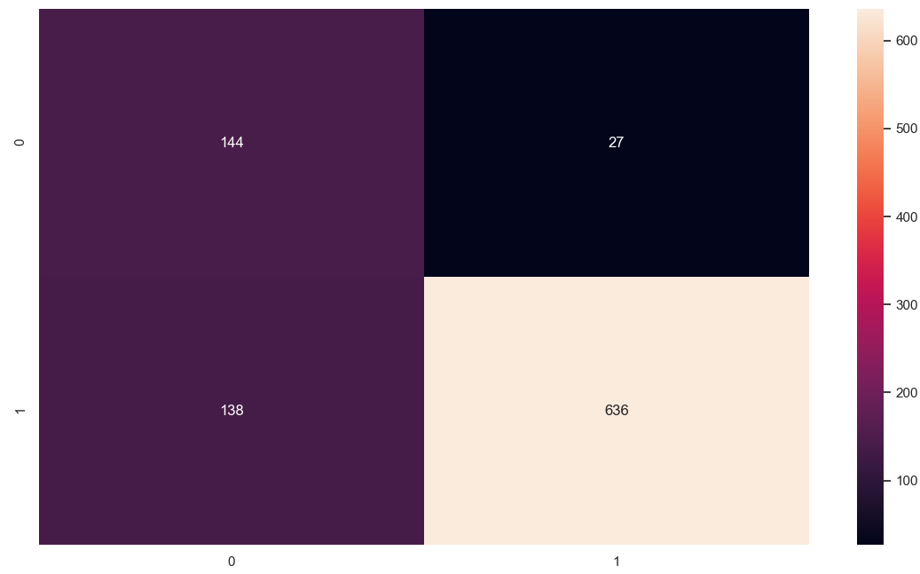
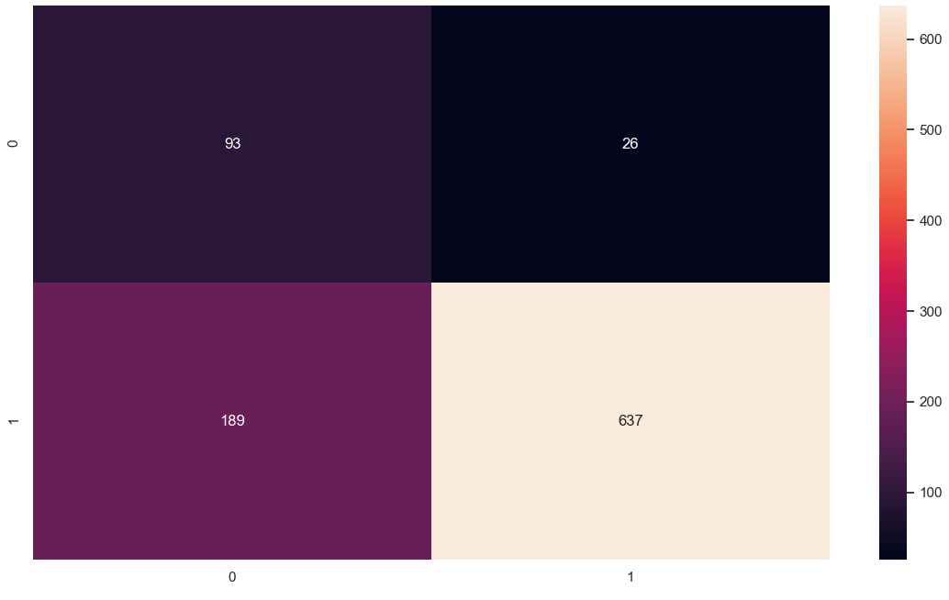
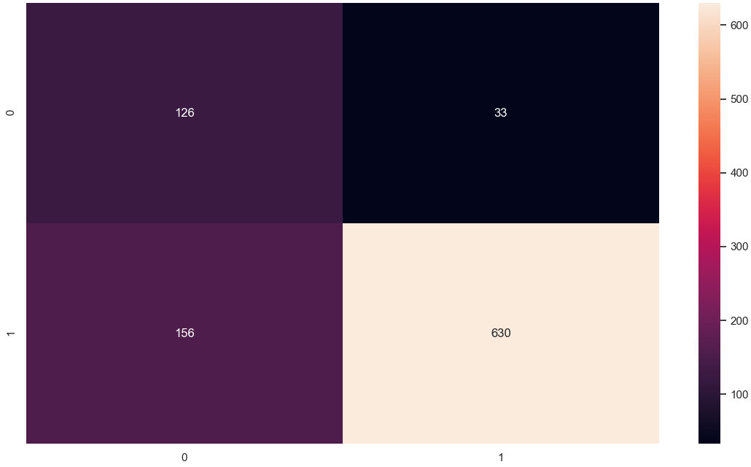

Confusion Matrix using Count-Vectorizer
Random Forest Classifier | Gaussian Naive Bayes
Multinomial Naive Bayes | Support Vector Machine
Random Forest: correctly classified 636 as positive reviews and 144 as not positive reviews.
Gaussian Naive Bayes: correctly classified 637 as positive reviews and 95 as not positive reviews.
Multinomial Naive Bayes: correctly classified 630 as positive reviews and 126 as not positive reviews.
Support Vector Machine: correctly classified 627 as positive reviews and 125 as not positive reviews.

Slide 20
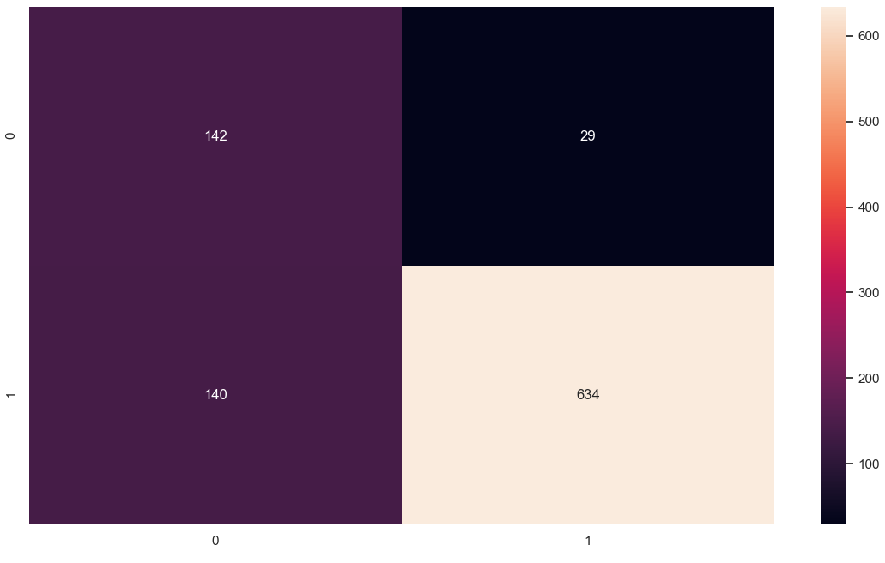
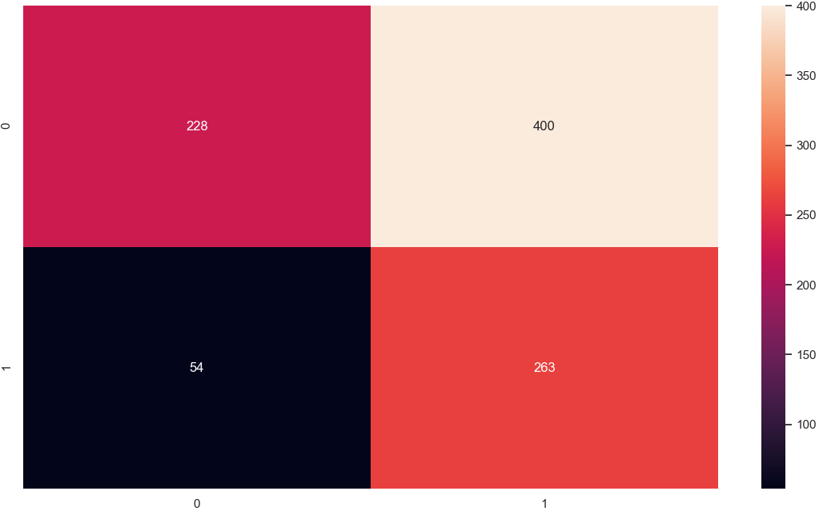
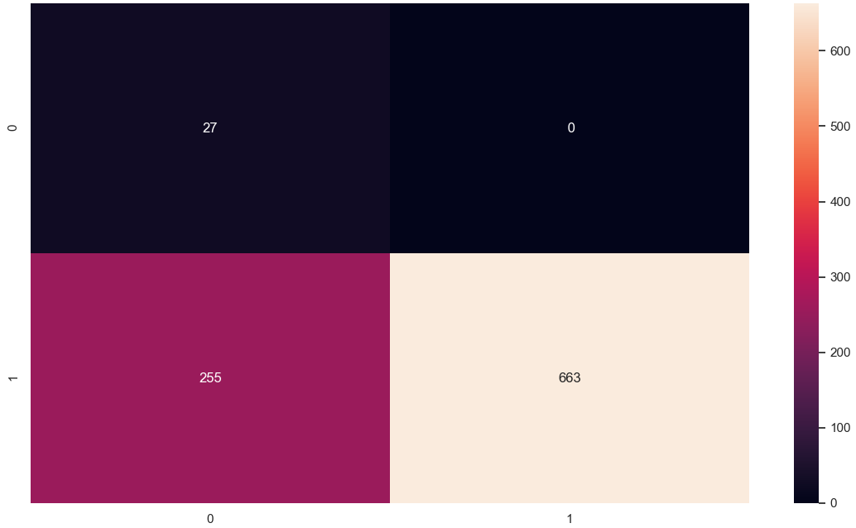
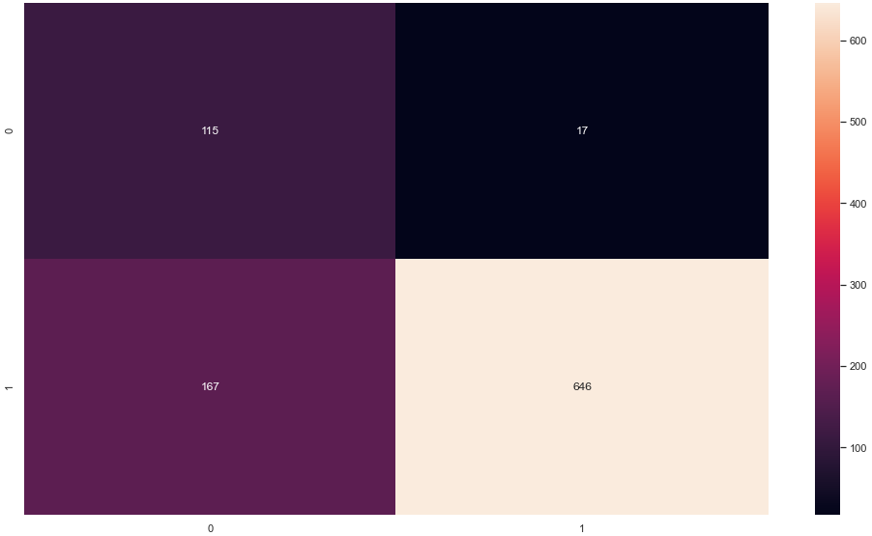
Confusion Matrix using TFIDF-Vectorizer
Random Forest Classifier | Gaussian Naive Bayes
Multinomial Naive Bayes | Support Vector Machine
Random Forest- correctly classified 634 as positive reviews and 142 as not positive reviews.
Gaussian Naive- correctly classified 263 as positive reviews and 268 as not positive reviews.
Multinomial Naive Bayes- correctly classified 663 as positive reviews and 27 as not positive reviews.
Random Forest- correctly classified 646 as positive reviews and 115 as not positive reviews.

Slide 21
Table 1: Results of all the Algorithm’s using Count-Vectorizer
Classifier | Accuracy | Precision | Recall | F1-Score
RANDOM FOREST | 82.53% | 82.17% | 95.92% | 88.51%
GAUSSIAN NAÏVE BAYES | 77.24% | 77.11% | 96.07% | 85.56%
MULTINOMIAL NAÏVE BAYES | 80.00% | 80.15% | 95.02% | 86.95%
SUPPORT VECTOR MACHINE | 79.57% | 79.97% | 94.57% | 86.66%
Table 2: Results of all the Algorithm’s using TFIDF-Vectorizer
Classifier | Accuracy | Precision | Recall | F1-Score
RANDOM FOREST | 82.11% | 81.91% | 95.62% | 88.23%
GAUSSIAN NAÏVE BAYES | 51.95% | 82.96% | 39.66% | 53.67%
MULTINOMIAL NAÏVE BAYES | 73.01% | 72.22% | 100.00% | 83.87%
SUPPORT VECTOR MACHINE | 80.52% | 79.45% | 97.43% | 87.53%

Slide 22
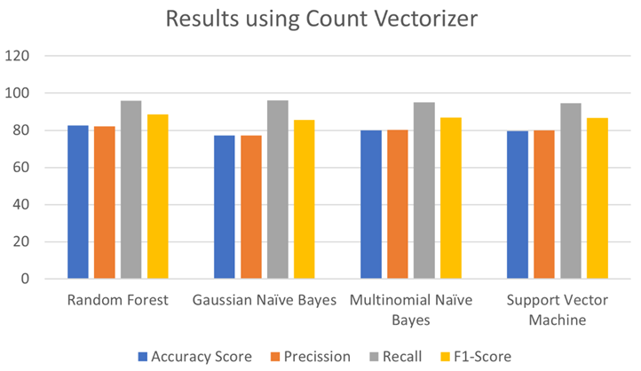
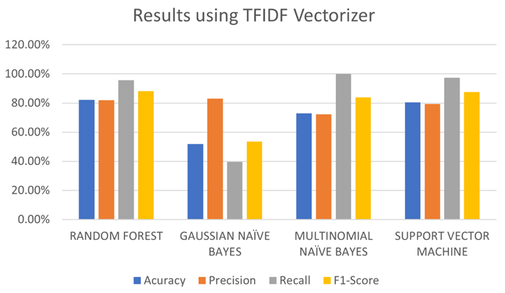
From the above bar graphs, on comparing the accuracy, precision , recall, F1-score, we came to know that with:
Count-Vectorizer Multinomial Naive bayes and Support Vector Machine provides the similar result, but Random Forest classification provides some better results.
For TFIDF-vectorizer , Random forest classification gave the better result than other algorithm.
After this, model tuning was done for the Random Forest Classification with CountVectorizer and got better result than the original with accuracy of 82.32% and F1 Score of 88.21%,

Slide 23
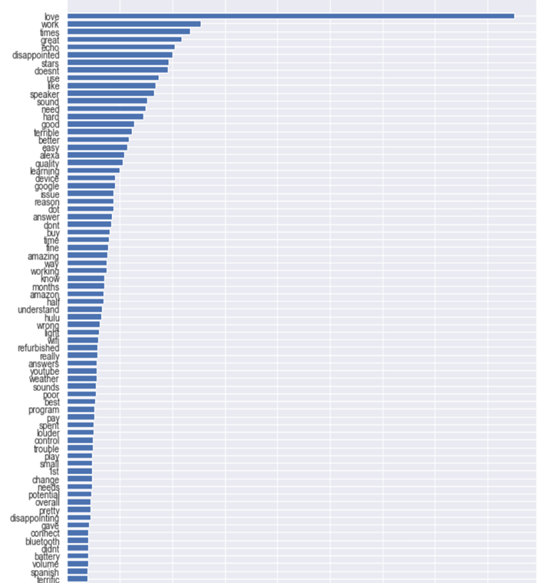
Feature Importance
The next thing that we want from this model tuning is we need to see the feature importances, so once the data classification is over,we implemented a bar histogram of all features(words) with the importance of each, and it started with all positive words and ended with negative words, that means our classification is done perfectly.

Slide 24
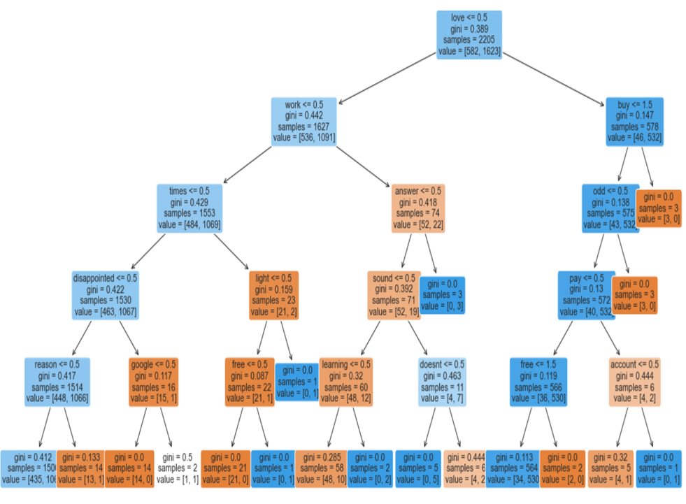
Tree Graph
So now we will plant the feature importance with the help of Tree Graph but using Decision Tree Classifier and passing the appropriate parameters using Graphviz and the results are astounding as we can see that importance of the features start with positive word love, then it comes to work, buy, times, etc followed by other words.
The other nodes, we can see how a simple decision tree model will classify the data into positive reviews or not.
But this is also very straight forward which is high on top left and it keeps decreasing towards the right bottom side.

Slide 25
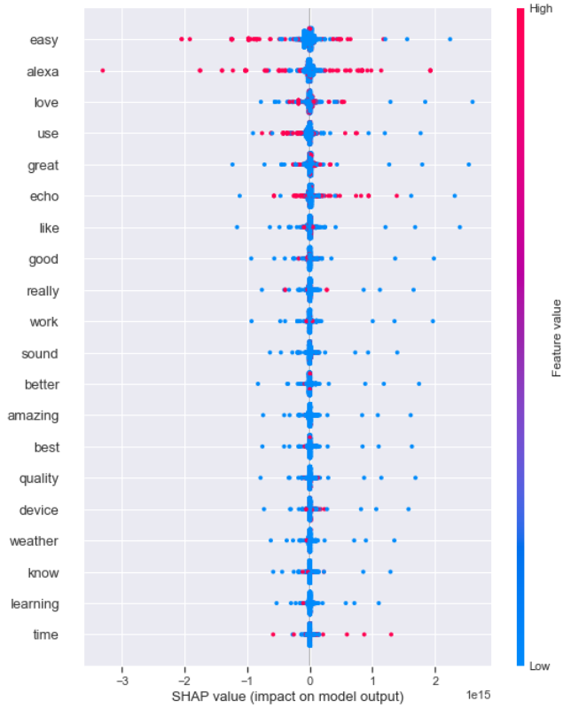
SHAP-TOOL
Since we want to know the predictions based on features, to better explain the mode chosen we will use a mathematical method called SHAP to explain the predictions of the Machine Learning model by calculating each feature contribution towards the prediction.
We can see here that all those words seen through the tree graph fall within this prediction towards positive means that most of the values are only effective between 1 and -1, which is a very good result.

Slide 26
Conclusion
From this whole model, it's good to know that for review classification Random Forest Classifier with CountVectorizer did a fantastic job. And upon tuning the balance between positive and negative results was incredible.
The tuned model helped us understand the feature importance and we could also see the features have an effect on each other.
The model tuning also helped us predict which features stand the best and we think most importantly it showed us which words and reviews have a positive impact and could literally let us understand that voice assistants are no longer the black box technology.
It helped us a lot in interpreting the mode, through analyzing the data was a very hard part, but once the analysis and transformation was completed, the amount of insights the dataset explained how the model makes predictions based on our input and stands out in front of a non-tech audience.

Slide 27
FUTURE
Now for future use cases let's consider how we and the generation are solely dependent on mobile phones and laptops, which are all connected to the Internet.
Now let's consider there is a family party organised at the last moment, so they either google or use voice assistant to search : "Hey Google, Can you tell me the best restaurant in Los Angeles ?”
Instantly google would spin this algorithm for all Dataset of restaurants and start looking at the reviews and the ones who would be having better reviews would be classified as 4.0 and above.
So It will start showing the results containing the restaurants with rating above 4.0, because the BEST in google is referred to as something > 4.0 rating.
Similarly, not only can we use this algorithm for Restaurants, but for vehicle purchase, based on the reviews the algorithm can classify whether the vehicle is safe, provides better miles and has less maintenance cost and accordingly its assigned the rating.
This kind of algorithm is now implemented by Global NCAP, where they are classifying the vehicles based on the level of safety. And the algorithm all shows is the rating and this is going to be a smart move for the future where people can purchase cars from home by just watching the reviews and the ratings.

Slide 28
Thank You!
Any Questions?

